Slide 1

Concert halls in Switzerland
A territorial analytic study

Slide 2
I. Introduction Culture is a major factor when measuring the attractivity of a city, it is monitored by the authorities and resources are invested every year (In Hungary 3.2% of the budget is dedicated to culture). There are regular discussions about cultural funding's, and here in Switzerland, the language situation (with 4 different official languages, but we will probably not have 'Romanche' speaking cities, given it is a rural population, and represents less than one % to the total population), and the federal regime, with highly independent states (called ‘canton’), makes this issue even more closely followed. One of the component of cultural activity, is the music scene, and one way to measure how lively is the musical scene in a city, is through the concert halls. The following study, aims to compare the major cities in Swizerland in terms of concert halls per capita, to provide an insight to the federal authorities, music professionals or simply to people interested in the cultural state of things from a numbers perspective, on the current distribution of the venues between the cities, opening the door for more focused studies on the budget side of things, to see how the discrepancies, if any, between the different territories could be explained, solved. By producing statistics such as number of venues per capita for each city, we should be able to have a look at the territorial repartition. As an experimentation, we will try, to create clusters of city by using machine learning library at the end of this document.

Slide 3
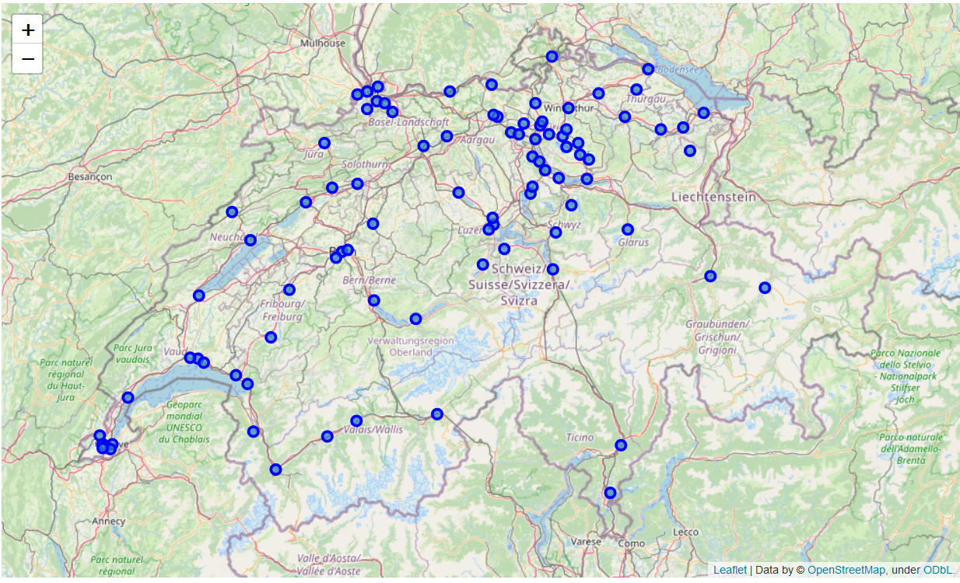
II. Data To explore Switzerland music venues, we will rely on two data sources A. Foursquare API Will allow us, to gather information on venues, in this study, we are mainly focused on the categories of the venues, and their locations. In the methodology part, we will discuss more technical details that have a big impact on our study B. Simple Maps Will allow us to retrieve basic data on Swiss cities, such as their geospatial coordinates (needed for drawing maps), the population, or the ‘canton’ to which they belong

Slide 4
III. Methodology (1/3) A. Cleaning the data As stated in the data part, we have gathered the information on the venues through Foursquare API, under some constraints : - Limited number of calls to the API allowed per day - Limits in the data reliability In order to make the most of what we had, we have filtered the tables through several manual steps, the details are available in the notebook attached to this presentation. B. Merging the two data sources Once the quality of the data on the venues was considered ‘acceptable’ both sources were merged in order to create the input for our

Slide 5
III. Methodology (2/2) C. Statistics to produce A repartition of the concert venues by ‘Canton’, will provide a first outlook on how balanced is the distribution of the music venues in Switzerland (Table A) A table providing the concert venue per capita for each city will allow us to have a first statistical answer to this question (Table B) D. Visual Analysis In addition to the tables, we will have two figures to help us read the data:0 - A horizontal bar chart, describing the table A. - Various maps, will add, visibility to the geographical part of the study. E. Clustering Finally, using, scikit library, we will try to cluster the swiss cities, to 4 different groups, based on the criteria ‘number of venues per capita’. As this part is only a complement to the statistical exploration, we will stay really basic in our method, using the scikit library.

Slide 6
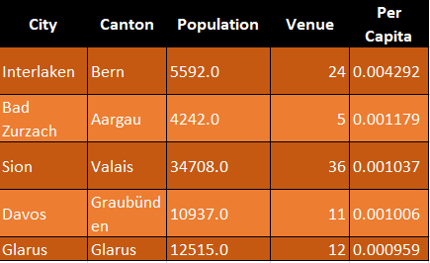
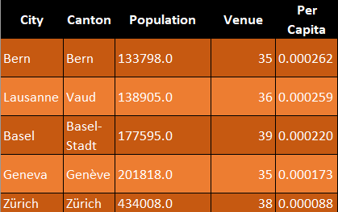
IV. Results (1/2)
Number of venues per capita
The top five ranks, are attributed to small cities, this highlights a bias, in our indicator (venue per capita) which will make some cities stand out, because of the population, ‘Bad Zurzach’ is an example, if we vary, the number of venues from 5 to 4, then its ranking will hugely decrease.
Top five cities
However, this still provides some usefull insights, as in absolute numbers Lausanne, which is 40% less populous than geneva, has more less the same number of concert venues, and therefore a lot high per capita index.
Biggest cities overview

Slide 7
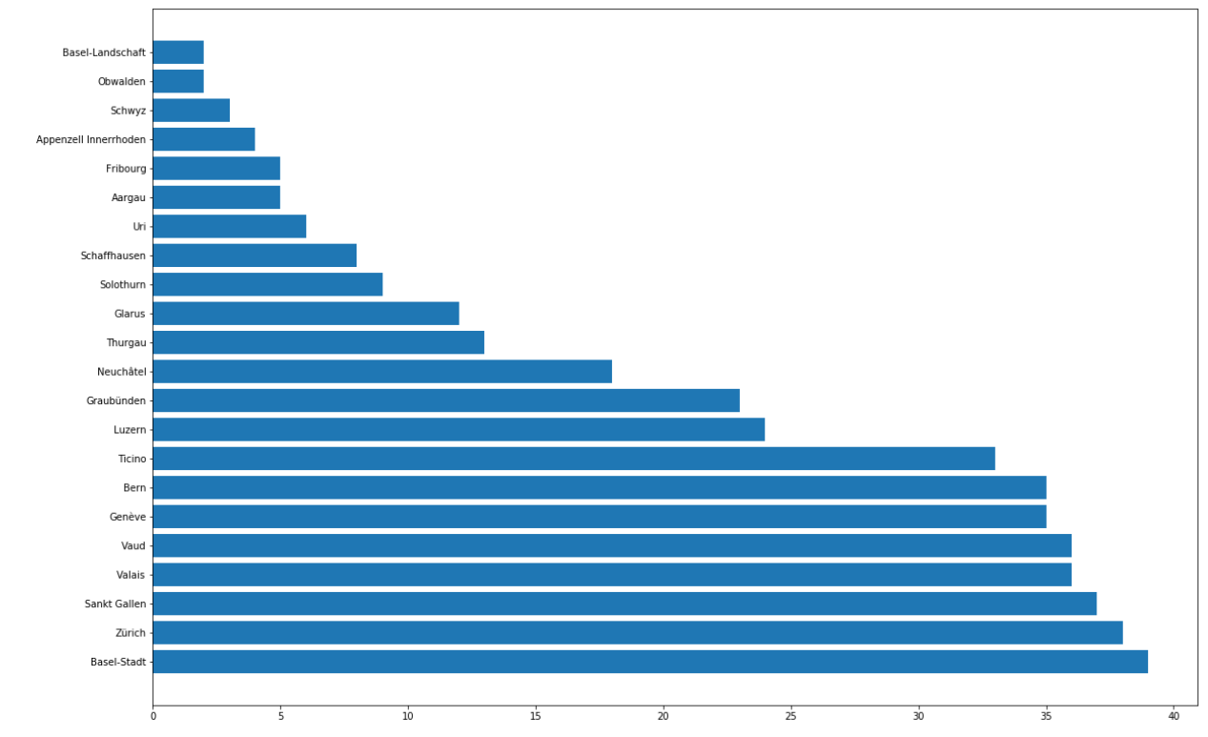
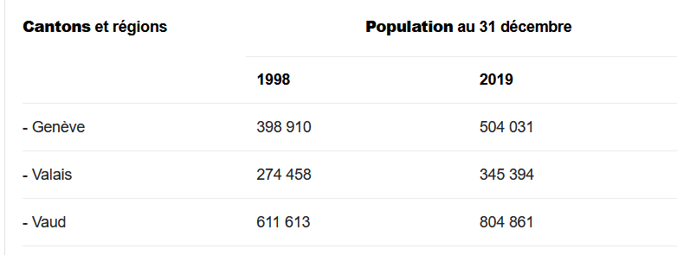
IV. Results (2/2)
Number of venues per state
- Valais which is not a populous state, is among the top five, when it comes to the number of venues.
- Same thing, can be said about Ticino.

Slide 8
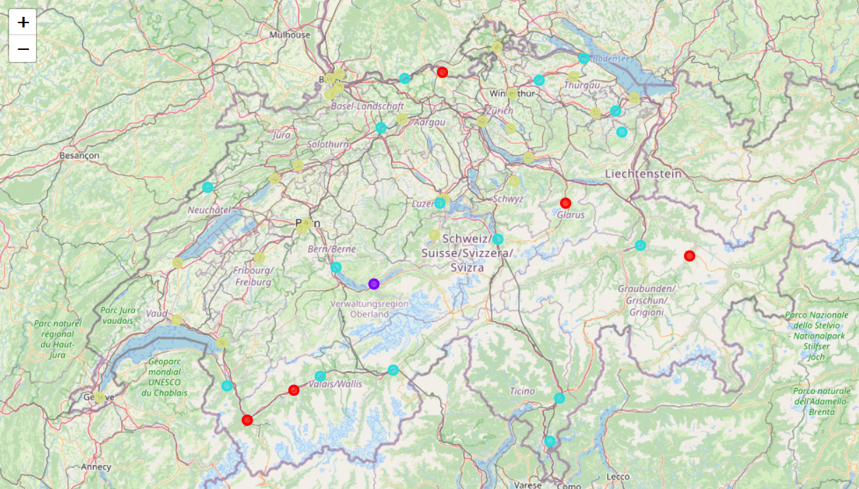
IV. Results (3/3)
Warning : This is just, an experimental attempt, to see how we could use now that the data is properly sorted, machine learning, and in this case, clustering to try to classify the cities.
By using our indicator, we have 4 distinct groups:
A group for cities with a very high venue per capita, which is constituted by a unique city : Interlaken, this might explained by the fact that the city is famous for holding different festivals all over the year, and being a touristic destination.
Second group, is also made of mainly small cities, and located all over the territory, they correspond to places known for a lively musical scene, or again, places that are touristic destinations all over the year.
Our third group, is basically, cities with an average indicator,
And finally, and this might be, the most interesting indication, the last group is the one where we find the biggest cities, this seems logical, as we’ve seen before that this indicator, has a bias and favours the small cities, but in this group, we also find smaller cities, that might be good targets for further analysis on how to make them more attractive.
Fribourg canton, is a good example, of a canton, with only cities with poor per capita venue indicators.
Clustering attempt

Slide 9
V. Discussion A. Data and data quality Foursquare limits, are real in this particular use case, not only the reliability of the data is questionable (category classification) but also the limitations due to the kind of account that was used (free developer account) which limits the number of results, might have altered the quality of the data. For more interesting statistics, other data like budget for the cultural department in each city, the number of yearly tourists, would also provide interesting insights.

Slide 10
VI. Conclusion : going further To conclude, thanks for your attention, and hopefully this gives a first glimpse at how numbers and data can improve our knowledge of the cultural scene in a given country. Lots of ideas, will come, with more data. It would be interesting to create a more detailed study, focusing on a smaller subset of towns, having the same kind of characteristics, and then try to build a better indicator, going probably further than only Switzerland, to have enough data, so data the results can be put into comparison with what is the situation in different countries (especially those cited as examples, Dublin, or Amsterdam).

